Slide 1


Department of Computer Science and Engineering
CS19P11 – Internet of Things Essentials
IOT BASED SMART PARKING SYSTEM USING PIR SENSORS
Karan Balaji R S-210701105
Kanaga Shanmugam P-210701103

Slide 2
Problem Statement and Motivation
Urban parking management faces challenges of inefficiency and congestion due to manual slot allocation and limited monitoring capabilities. Current systems lack automation, leading to frustration among drivers and inefficient space utilization. Our project addresses this by developing a Smart Parking System taking advantage of Arduino and infrared sensors. The system aims to automate parking slot allocation, provide real-time availability information, and enhance user experience for both drivers and facility managers. By offering seamless integration of hardware and software solutions, our system strives to alleviate parking challenges and optimize space utilization in urban environments.

Slide 3
Objectives
To harness the power of technological advancements into the field of IOT to enable smart parking system for ease of use.

Slide 4
Abstract
This project introduces an advanced parking management system by using Arduino and infrared sensor technology. The system automates parking slot allocation and monitoring processes, enhancing efficiency and user experience. Utilizing Arduino as the central control unit, along with strategically placed infrared sensors, the system detects vehicle presence and coordinates barrier operations accordingly. Upon vehicle detection by the first sensor, the system triggers the servo motor to open the barrier, allowing entry. Conversely, when the vehicle departs, sensed by the second sensor, the system promptly closes the barrier, signaling slot availability. This automation reduces human intervention, minimizing errors and ensuring seamless operation. Furthermore, real-time monitoring capabilities empower administrators with valuable insights into parking occupancy trends, facilitating informed decision-making. Ultimately, our solution streamlines parking procedures, optimizing space utilization, and providing a user-friendly experience for both drivers and parking facility managers.

Slide 5
Introduction
The rapid increase in car ownership has highlighted the need for more efficient parking systems. Traditional parking methods often fall short in meeting the demands of modern urban environments. Problems such as traffic congestion, inadequate parking space, and inefficient parking management are common in many cities.
These issues not only frustrate drivers but also have broader implications for urban mobility and environmental sustainability. For instance, the time spent searching for parking contributes significantly to traffic congestion and increased fuel consumption, exacerbating air pollution and greenhouse gas emissions.
Efficient parking management systems are essential to address these challenges. Modern technology offers promising solutions to optimize parking processes and enhance the user experience.
Automated parking systems, which leverage advancements in sensors, microcontrollers, and real-time data processing, can significantly improve how parking facilities operate.

Slide 6
Literature Survey
In today's world, population growth has led to more cars on the road, causing traffic and parking shortages. Illegal parking poses security risks. This paper [1] introduces an Intelligent Prepaid Car Parking system using RFID technology. It aims to solve parking space and vacancy issues while ensuring car safety. The system reduces manual work, making it more efficient. Tested on Xilinx Vivado 15.4, it uses minimal resources: 0.07% LUT, 0.03% Flip flops, 14.5% IO's, and 3.2% buffers.
This paper [2] presents an IoT-based smart parking system as a solution to the shortcomings of traditional parking systems. It consists of parking management and user applications, along with an IoT platform deployed at both parking slot and parking lot levels. Using IoT hardware, the system tracks slot availability and vehicle movements. Crowdsensing from users and staff helps minimize sensor usage. Implemented at X University, the system receives high usability scores of 91 from staff and 80.14 from users, indicating its effectiveness and user-friendliness.
This project [3] introduces an automated parking system to alleviate the challenges of manual parking methods. Drivers can now easily identify vacant parking spots and their numbers before entering, thanks to monitor screens at entry gates. Only authorized individuals with RFID tags are granted access based on parking space availability. Moreover, a convenient parking fee management system allows payments through the same RFID tag, functioning as a rechargeable parking credit card.

Slide 7
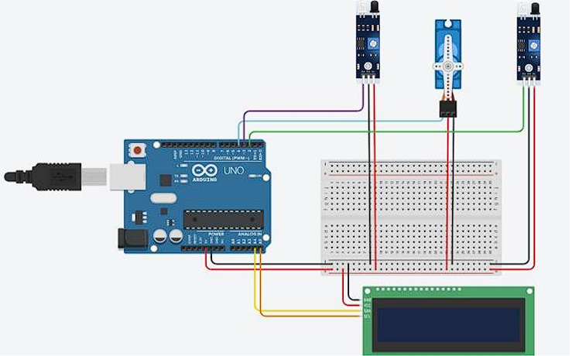
System Design
CIRCUIT DIAGRAM:
The circuit diagram explains the connections made with the hardware components and the board. The Arduino uno is connected with the breadboard as the VCC and GND are connected with the rails. The Sensors, LCD and Servo motor is given connection with the rails and the other input/output pins are connected to digital as per the requirements.

Slide 8
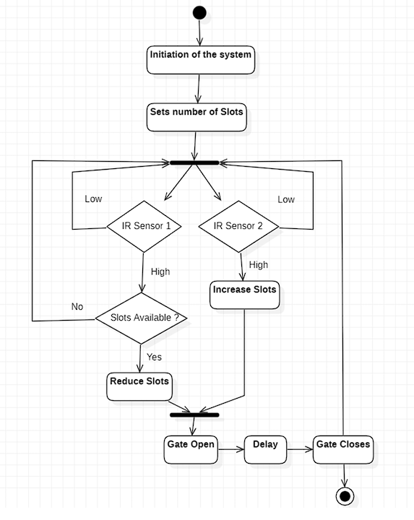
System Design
FLOW DIAGRAM:
The Diagram Explains that there are two sensors which acts as the decision taking modules for the built application. The doors will be open until the sensor is high and slot is available. This also provides a schematic view of how the coding part of the application should be. Slots plays a vital role in assigning the cars in specific parking.

Slide 9
List of Modules
ARDUINO UNO:
This is microcontroller setup for the car parking system which acts as the CPU of the whole system. This takes inputs from the Sensors and triggers the actuators.
IR-SENSOR:
This sensor is used to trigger an event at the time of car’s entry or exit and sends the information to the controller.
LCD MODULE:
This module is used to notify about the availability of slots in the parking.

Slide 10
List of Modules
SERVO MOTOR:
This module is the actuator of the system which controls the gate based on the decisions taken by the controller of the system.
I2C MODULE:
This is used as a communication medium between the LCD module and Controller just utilizing 4 pins from the controller whereas to connect LCD directly it needs more pins.

Slide 11
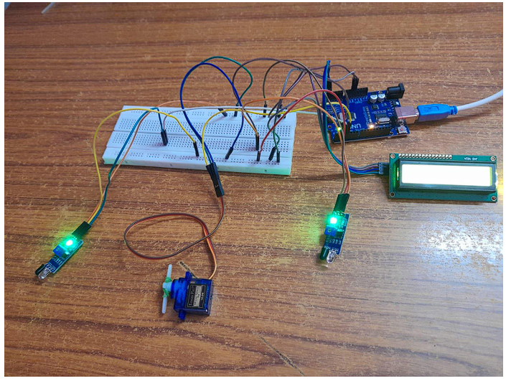
Implementation/Results of Module
Upon successful connection, light will be light up in the LCD module and one out of the two lights in the IR sensors will light up denoting power supply and successful connection. In the figure if the left most IR sensor, detects motion of any vehicle, it will activate the servo motor and will in turn reduce the number of parking slots available. When the number of parking slots reduce to 0, the servo motor will not activate even if the first infrared sensor detects an object. The second infrared sensor helps in increasing the number of slots available as each time this sensor detects an object, it will increase the number of parking slots available thereby activating the servo motor.

Slide 12
Conclusion
In conclusion, the smart car parking system provides a best alternative solution for the manual car parking systems using cost effective measures and ensuring that the system works for perfection. This also have the capabilities to fulfil the requirements of great smart cities in general on the basis of parking. Implementing this system won’t require much maintenance.
For future enhancements, the system for parking could be enlarged to multistorey parking. Each level’s gateway can have a microcontroller along with sensors to multiply the original use of the system, The second feature to be added will be usage of
RFID tags to allow only authorized cars or employing a payment system based on RFID within the cars. The next feature includes using a camera sensor to identify tags plastered on the car’s windshield like fast tags to maintain pay and park systems.

Slide 13
References
[1] RVS Technical Campus, IEEE Electron Devices Society, and Institute of Electrical and Electronics Engineers, Proceedings of the Second International Conference on Electronics, Communication and Aerospace Technology (ICECA 2018) : 29-31, May 2018.
[2] R. Widyasari, M. Z. Catur Candra, and S. Akbar, “IoT-based Smart Parking System Development,” in Proceedings of 2019 International Conference on Data and Software Engineering, ICoDSE 2019, Institute of Electrical and Electronics Engineers Inc., Nov. 2019. doi: 10.1109/ICoDSE48700.2019.9092707.
[3] A. Z. M. T. Kabir, N. D. Nath, F. Hasan, R. A. Utshaw, and L. Saha, “Automated Parking System with Fee Management Using Arduino.”
[4] B. Shukla et al., 2016 5th International Conference on Reliability, Infocom Technologies and Optimization (ICRITO) (Trends and Future Directions) : September 7-9, 2016, venue, Amity University Uttar Pradesh, Noida, India.
[5] Jeppiaar Engineering College and Institute of Electrical and Electronics Engineers, ICONSTEM 2017 : Digital India and Smart Cities : proceedings : Third IEEE International Conference on Science, Technology, Engineering and Management : 23rd & 24th March 2017, Jeppiaar Engineering College, Jeppiaar, Nagar, Rajiv Gandhi Salai, Chennai - 600 119.

Slide 14
Github Links
Github Links:
1. https://github.com/kanagashanmugamp/210701103-CS19P11-IoT-Lab

Slide 15
Thank You

